Slide 1
2017 UBS Group Technology and Operations Case Challenge
Adrian Lim, Desmond Wong, Nicholas Loh
Singapore Management University

Slide 2
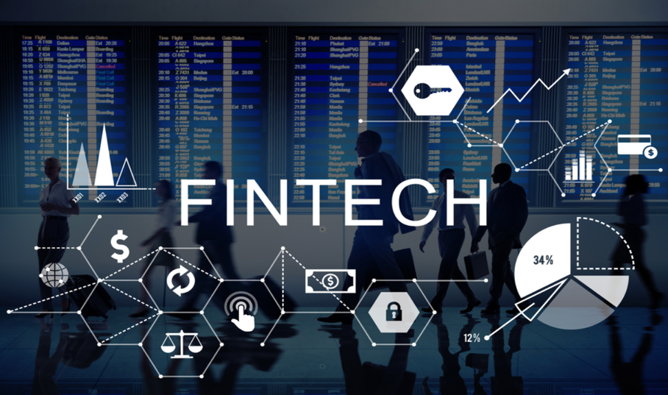
Challenges
External Challenges
Growing Integration of International Stock Markets
Emergence of Disruptive Technology
Challenges | Integration of Technology | Manpower Allocation | Business Value Gains | Operational Risks | Sustainability Policies | Scalability | Timeline of Implementation | Moving Forward

Slide 3
Challenges
Internal Challenges
Human Error : Fat-Finger Error
Fat-finger error is a human error caused by pressing the wrong key when using a computer to input data
Challenges | Integration of Technology | Manpower Allocation | Business Value Gains | Operational Risks | Sustainability Policies | Scalability | Timeline of Implementation | Moving Forward

Slide 4
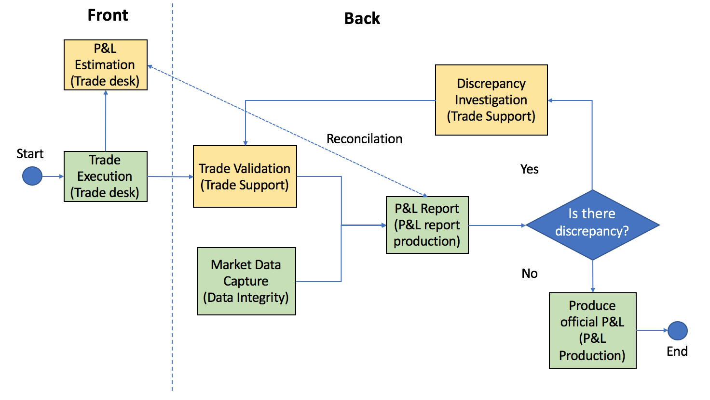
Challenges
Internal Challenges
ORIGINAL
PROCESS
Non-value add
Value add
Challenges | Integration of Technology | Manpower Allocation | Business Value Gains | Operational Risks | Sustainability Policies | Scalability | Timeline of Implementation | Moving Forward

Slide 5
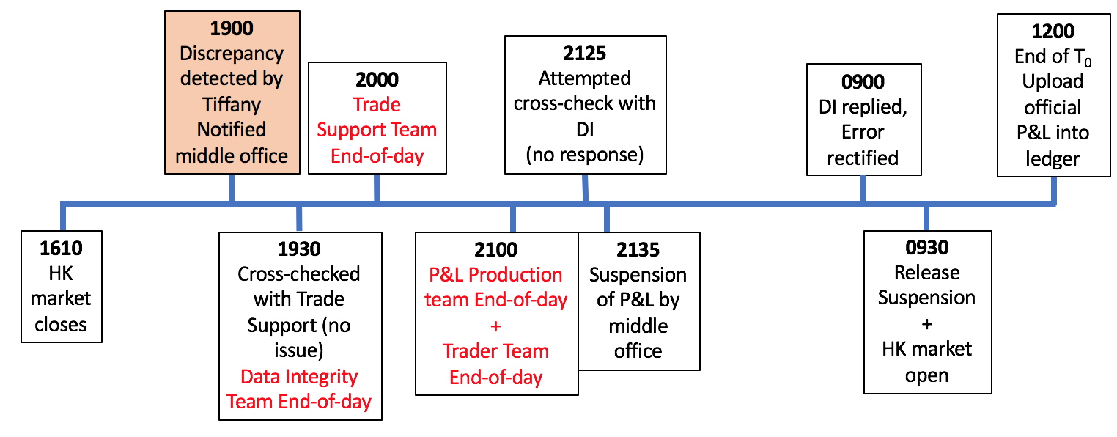
Challenges
Internal Challenges
TIMELINE
Challenges | Integration of Technology | Manpower Allocation | Business Value Gains | Operational Risks | Sustainability Policies | Scalability | Timeline of Implementation | Moving Forward

Slide 6
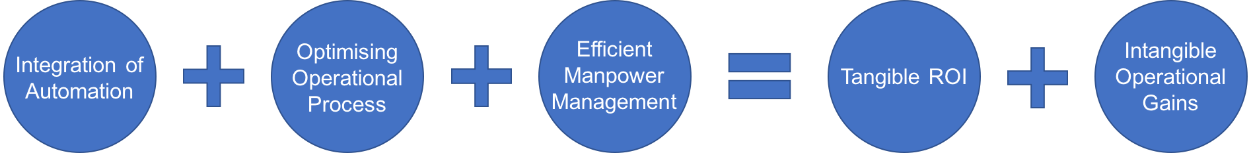
Proposed Strategy
Challenges | Integration of Technology | Manpower Allocation | Business Value Gains | Operational Risks | Sustainability Policies | Scalability | Timeline of Implementation | Moving Forward

Slide 7
Integration of Technology
Proactive, Transformative
Original Process
Can we re-engineer the process?
How to improve the bottleneck?
How to resolve the root cause of the problem?
Challenges | Integration of Technology | Manpower Allocation | Business Value Gains | Operational Risks | Sustainability Policies | Scalability | Timeline of Implementation | Moving Forward

Slide 8
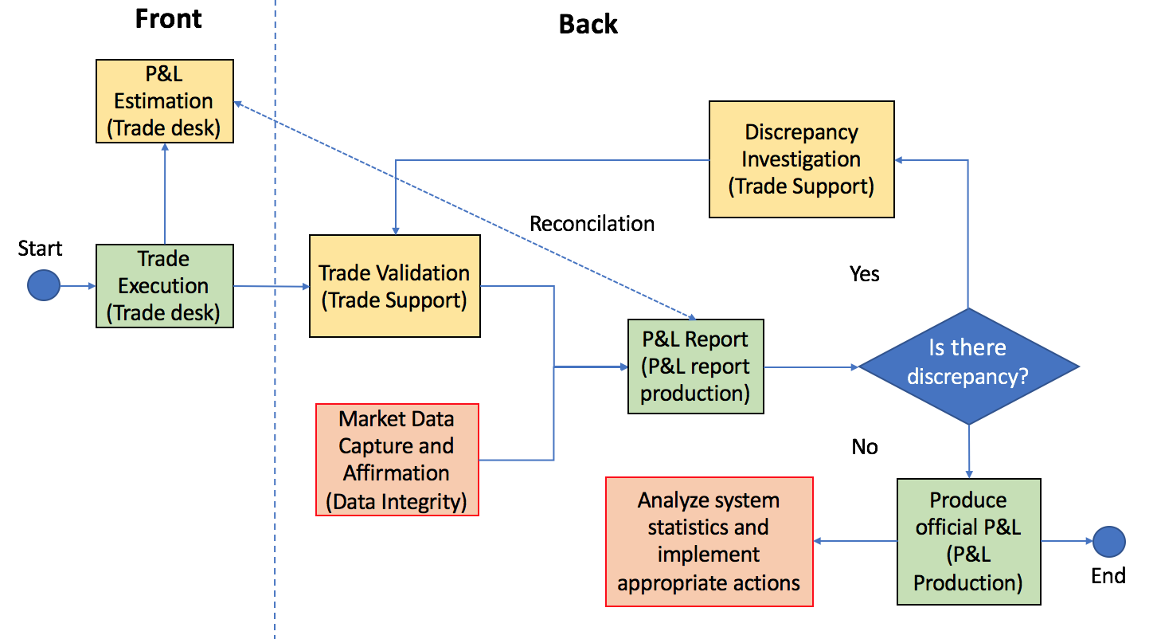
Integration of Technology
Proactive, Transformative
Improvised Process
Human error by DI team is the root cause of the problem
The use of Maker-Checker software to ensure error-free dynamic data collection
Traders able to utilize data from MarketBox to aid in their estimation
Performance data (e.g. system efficiency, employee productivity) will be recorded and analyzed by management
Transformative
Proactive
Challenges | Integration of Technology | Manpower Allocation | Business Value Gains | Operational Risks | Sustainability Policies | Scalability | Timeline of Implementation | Moving Forward

Slide 9
Integration of Technology
Proactive: Maker-Checker (Maker Process)
Automated software for Data Integrity Team
Utilizes Bloomberg Excel’s add in to retrieve prices of stocks
Map data directly to MarketBox
The process will be automated and conducted without human’s interaction
Assumptions
EliteBank subscribes to Bloomberg Terminal
MarketBox is compatible with Excel
EliteBank source from external providers to create this automated software (i.e. RPA service provider from the consulting arm such as Accenture)
Challenges | Integration of Technology | Manpower Allocation | Business Value Gains | Operational Risks | Sustainability Policies | Scalability | Timeline of Implementation | Moving Forward

Slide 10
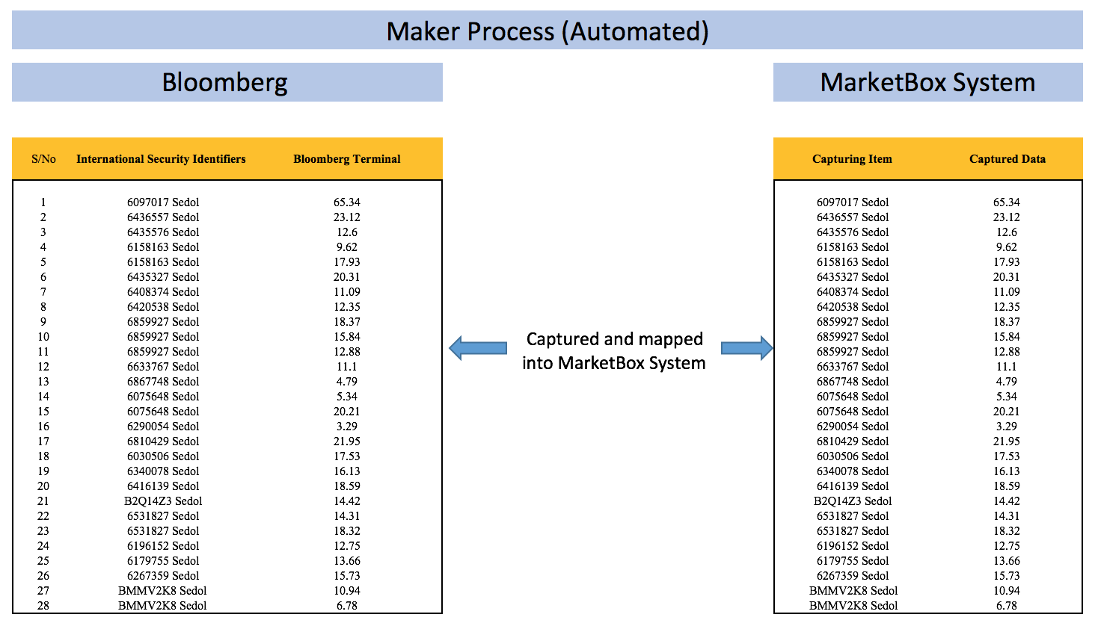
Integration of Technology
Proactive: Maker-Checker (Maker Process)
e.g. =BDH(“6097017 Sedol”, “PX_LAST”, “7/13/2017 3:00:00 PM”, “7/13/2017 3:00:01 PM)
Challenges | Integration of Technology | Manpower Allocation | Business Value Gains | Operational Risks | Sustainability Policies | Scalability | Timeline of Implementation | Moving Forward

Slide 11
Integration of Technology
Proactive: Maker-Checker (Checker Process)
Checker software for Data Integrity Team
Retrieve data from MarketBox in the form of spreadsheets
Utilizing VBA and Excel functions (i.e. INDEX, MATCH) to verify data instantly
Process operated by human
Assumptions
Ability to export data in the form of Excel spreadsheet
Challenges | Integration of Technology | Manpower Allocation | Business Value Gains | Operational Risks | Sustainability Policies | Scalability | Timeline of Implementation | Moving Forward

Slide 12
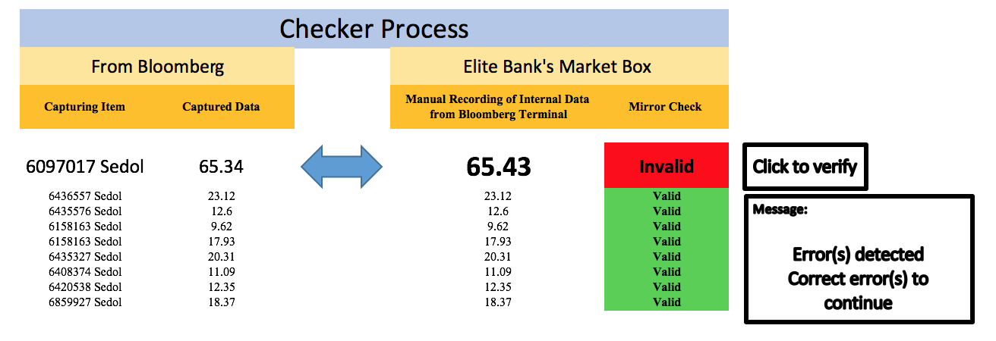

Integration of Technology
Proactive: Maker-Checker (Checker Process)
Challenges | Integration of Technology | Manpower Allocation | Business Value Gains | Operational Risks | Sustainability Policies | Scalability | Timeline of Implementation | Moving Forward

Slide 13
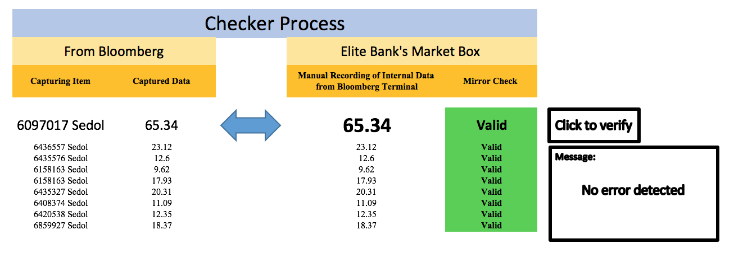
Integration of Technology
Proactive: Maker-Checker (Checker Process)
Challenges | Integration of Technology | Manpower Allocation | Business Value Gains | Operational Risks | Sustainability Policies | Scalability | Timeline of Implementation | Moving Forward

Slide 14
Integration of Technology
Proactive: Maker-Checker
Risks of the Proactive measure:
Bloomberg may provide inaccurate data (degree of risks: Low)
Automated software outage due to runtime error (degree of risks: Low)
Risks mitigation:
EliteBank can subscribe to multiple source providers to ensure credibility of data
Software is to be programmed to notify IT team immediately once there is a software outage
Challenges | Integration of Technology | Manpower Allocation | Business Value Gains | Operational Risks | Sustainability Policies | Scalability | Timeline of Implementation | Moving Forward

Slide 15
Integration of Technology
Transformative
Data analytics software for management personnel:
Fully customizable dashboard to analyze Elite Bank’s performance
Included but not limited to Manpower Allocation and Incident Analysis
Challenges | Integration of Technology | Manpower Allocation | Business Value Gains | Operational Risks | Sustainability Policies | Scalability | Timeline of Implementation | Moving Forward

Slide 16
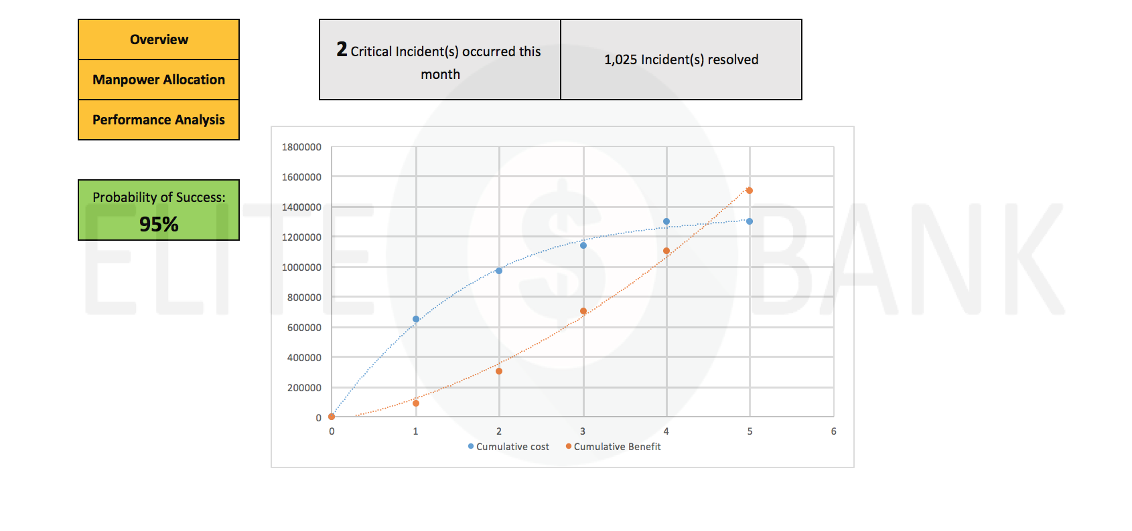

Integration of Technology
Transformative
Overview Page shows key facts such as the number of critical incident that occurred and the current progress of the implementation
Challenges | Integration of Technology | Manpower Allocation | Business Value Gains | Operational Risks | Sustainability Policies | Scalability | Timeline of Implementation | Moving Forward

Slide 17
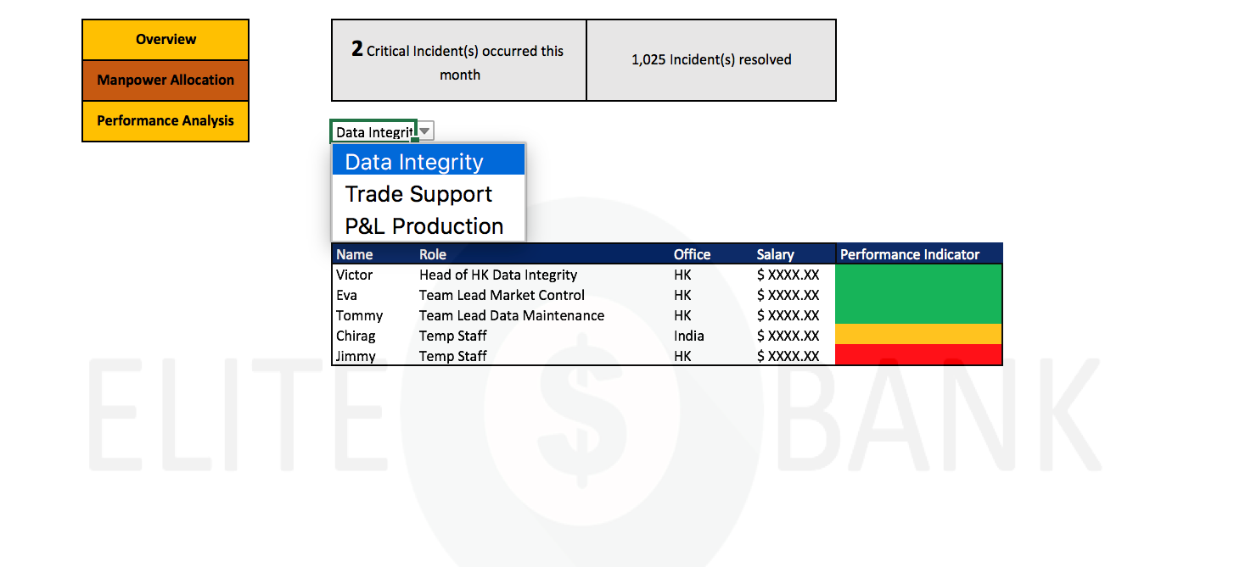

Integration of Technology
Transformative
Manpower Allocation Page shows the details of employees
Challenges | Integration of Technology | Manpower Allocation | Business Value Gains | Operational Risks | Sustainability Policies | Scalability | Timeline of Implementation | Moving Forward

Slide 18
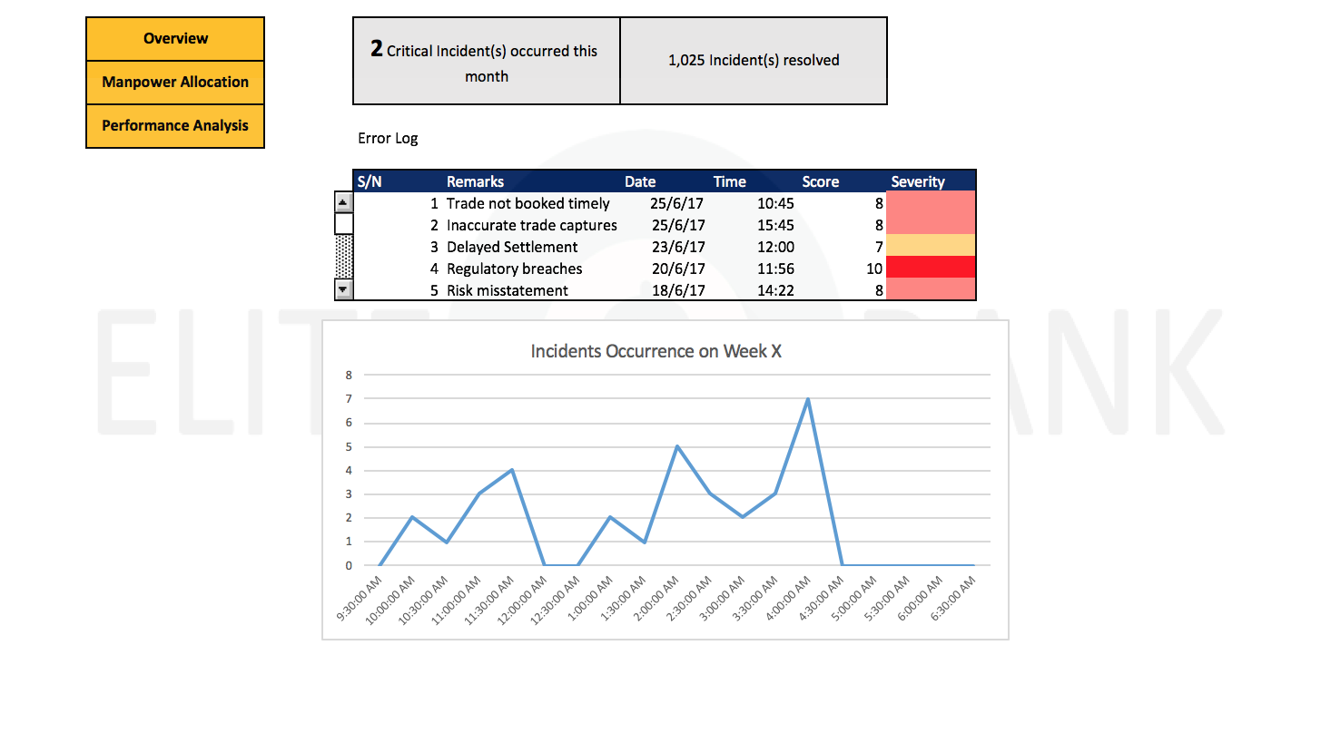

Integration of Technology
Transformative
Incident Analysis page shows the Error Log and customizable charts to allow in-depth analysis of incidents
Challenges | Integration of Technology | Manpower Allocation | Business Value Gains | Operational Risks | Sustainability Policies | Scalability | Timeline of Implementation | Moving Forward

Slide 19
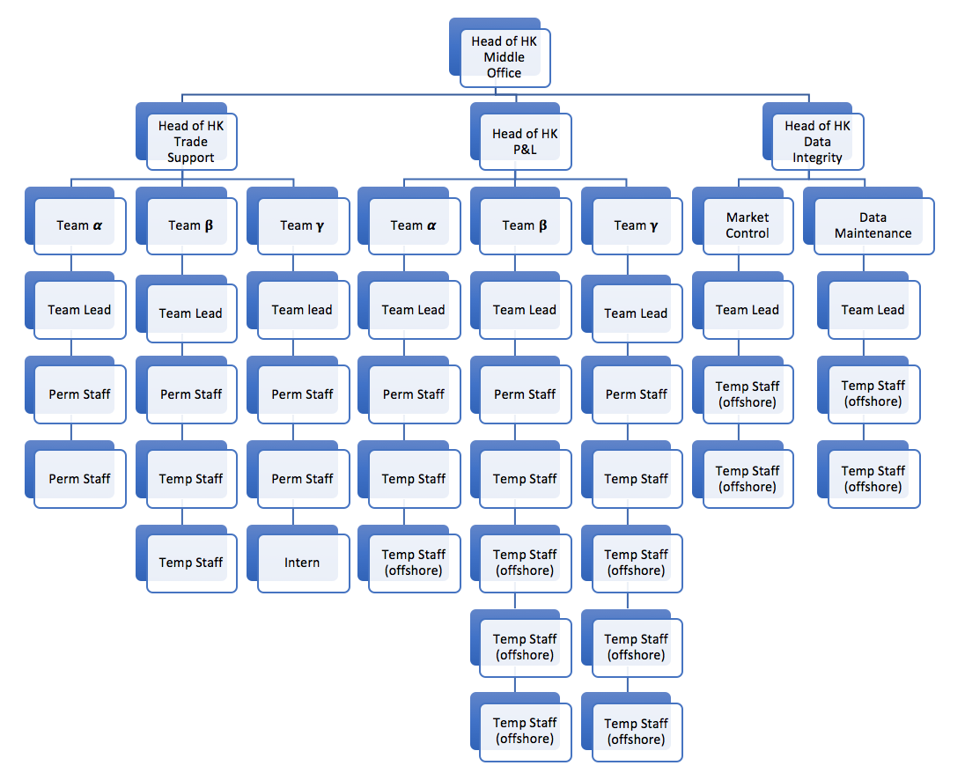
Manpower Allocation
Layout
According to Capgemini, Robotics Process Automation (RPA) can replace on average 4 employees
Elite Bank can afford to have a smaller but specialized team
Outsource to developing countries like China and India
Robot
Challenges | Integration of Technology | Manpower Allocation | Business Value Gains | Operational Risks | Sustainability Policies | Scalability | Timeline of Implementation | Moving Forward

Slide 20


Manpower Allocation
Off-Shoring (Lower Cost)
Hong Kong P&L Production Team
Hong Kong Data Integrity Team
Better understanding of local stock market (Shenzhen)
Shares common dialect and working culture
India’s time zone (GMT +5.5)
Indian workers available till 2200 hours in HK time
Challenges | Integration of Technology | Manpower Allocation | Business Value Gains | Operational Risks | Sustainability Policies | Scalability | Timeline of Implementation | Moving Forward

Slide 21
Business Value Gains
Tangible and intangible benefits
Tangible benefit
USD
According to Forrester, the cost of an RPA robot will range from $5,000 to $10,000 annually
Assuming the cost of the robot is $10,000 and a robot can replace 2 FTE
Salary of an offshore workers $8,000 (Kelly Services)
Initial investment = $10,000
Time to receive return of investment = 7.5 months
PROPOSED SOLUTIONS
7.5
No. of months
Intangible benefit
Better employee performance due to automation relieving the pressure from the time-sensitive deadlines which will subsequently translate into better customer services.
Challenges | Integration of Technology | Manpower Allocation | Business Value Gains | Operational Risks | Sustainability Policies | Scalability | Timeline of Implementation | Moving Forward

Slide 22
Operational Risks
1. Vendor Selection – Poor alignment of vendor’s tools, methodologies and business processes with Elite Bank’s business aims may increases the probability of process failure
2. Robotics Automation Configuration – Although RPA is able to function without human interaction, it still requires a lot of human attention. (i.e. RPA processing standardized data, requiring maintenance & upgrades, changes in processes upstream or downstream may greatly affect the process the RPA is functioning in)
3. Business Sustainability – Staff unaware of protocols when systems fail may cause inability to process and resolve critical incident. Offshored staff are especially vulnerable to such risks due to the geographic barrier
Challenges | Integration of Technology | Manpower Allocation | Business Value Gains | Operational Risks | Sustainability Policies | Scalability | Timeline of Implementation | Moving Forward

Slide 23
Sustainability Policies
In order to increase the success rate of the project in the long run, there are a few key sustainability policies that Elite Bank could implement.
Strong Leadership
Communication
Well-defined roles and responsibilities need to be enforced
Organizational leaders need to ensure that employees adhere strictly to their assigned roles and responsibilities.
Operational progress or failures have to be well communicated from bottom-up
Have divisional and executive meetings on a regular basis covering successful implementations and feedback on poor performances.
Challenges | Integration of Technology | Manpower Allocation | Business Value Gains | Operational Risks | Sustainability Policies | Scalability | Timeline of Implementation | Moving Forward

Slide 24
Sustainability Policies
Talent acquisition
According to IDC, by 2020, 35% of robotics related jobs will be vacant
Creating an IT ecosystem that is forged through collaboration with tertiary institutions and government agencies
Technical training offered to fresh graduates regardless of discipline of degree
Challenges | Integration of Technology | Manpower Allocation | Business Value Gains | Operational Risks | Sustainability Policies | Scalability | Timeline of Implementation | Moving Forward

Slide 25
Scalability
Through Automation and Quality Control of Data
Does not require improvement in infrastructure that is expensive and time-consuming
Automated robotics software can be configured and trained in a short span of time (weeks)
Elegant programming of software which allows employees to operate and maintain the robot easily
Challenges | Integration of Technology | Manpower Allocation | Business Value Gains | Operational Risks | Sustainability Policies | Scalability | Timeline of Implementation | Moving Forward

Slide 26
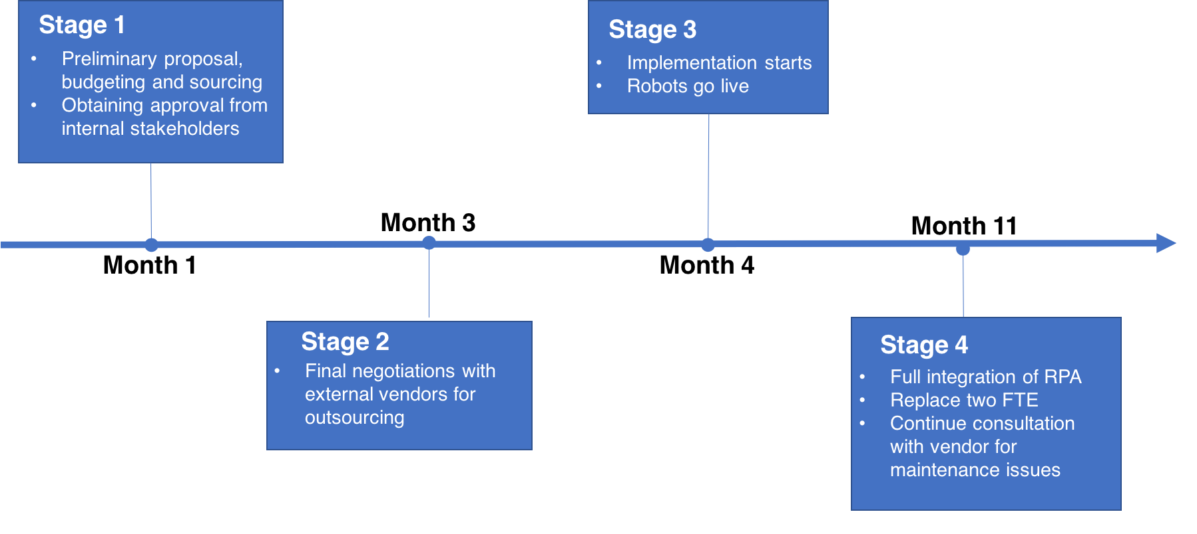
Timeline of Implementation
Challenges | Integration of Technology | Manpower Allocation | Business Value Gains | Operational Risks | Sustainability Policies | Scalability | Timeline of Implementation | Moving Forward

Slide 27
Moving forward
RPA will be the future norm of the finance industry
Established banks such as ANZ, ICICI Bank and Barclays have already implemented RPA, and experienced significant response time
RPA has the potential to save hundreds of thousands annually if it is implemented throughout the back office
It is time to embrace this disruptive technology and mitigate the risks associated with it!

